Slide 1

GAUSSIAN NOISE
Nada Janković 468-12

Slide 2
Image Processing
ONE PIXEL

Slide 3

Image Processing + Dataflow
ONE PIXEL

Slide 4

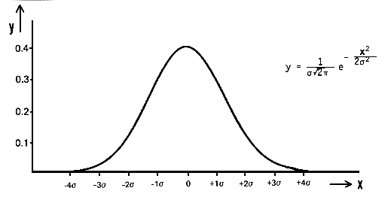

Formula

Slide 5
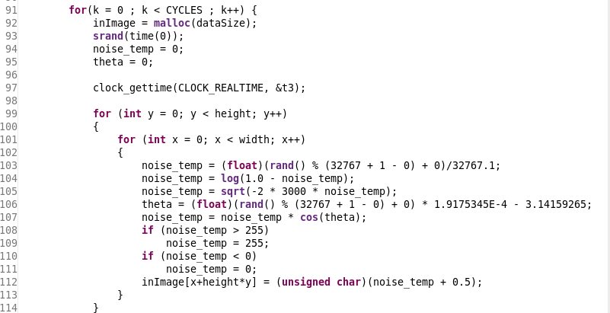
Sequential Code

Slide 6
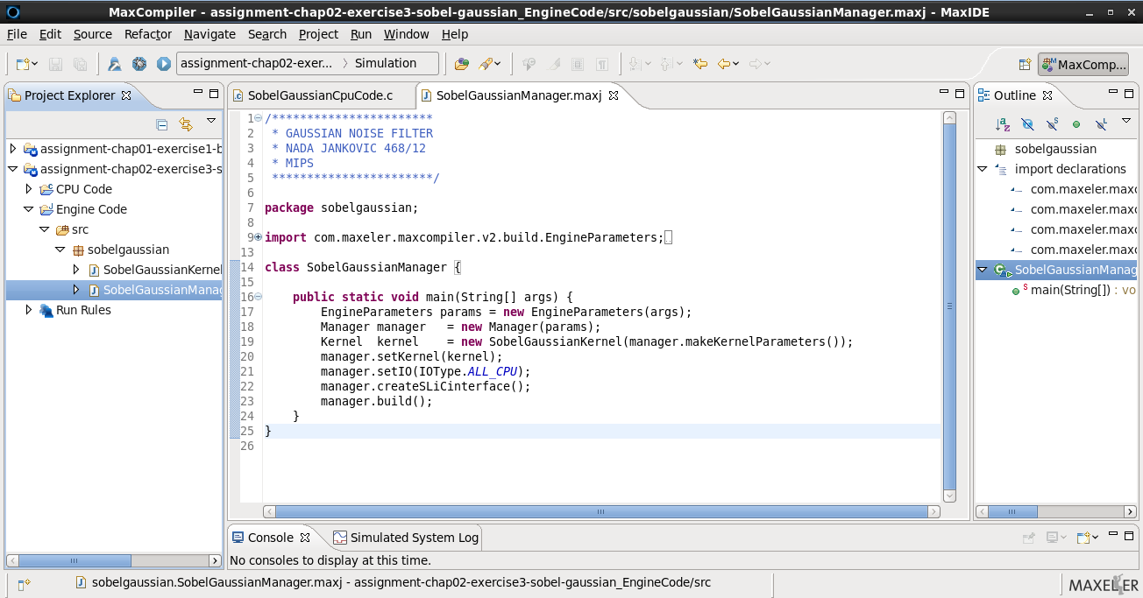
Maxeler Manager

Slide 7
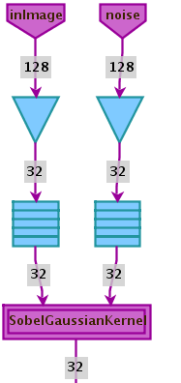
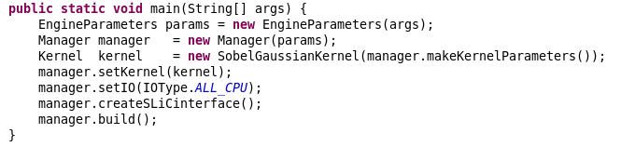
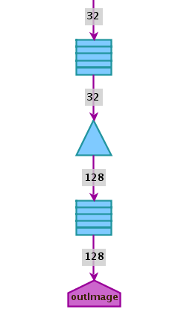
Maxeler Manager Graph

Slide 8
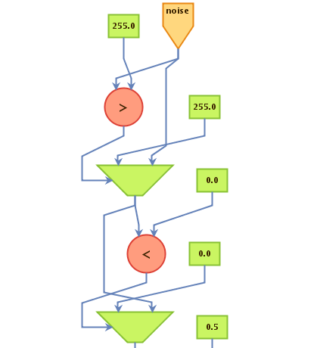
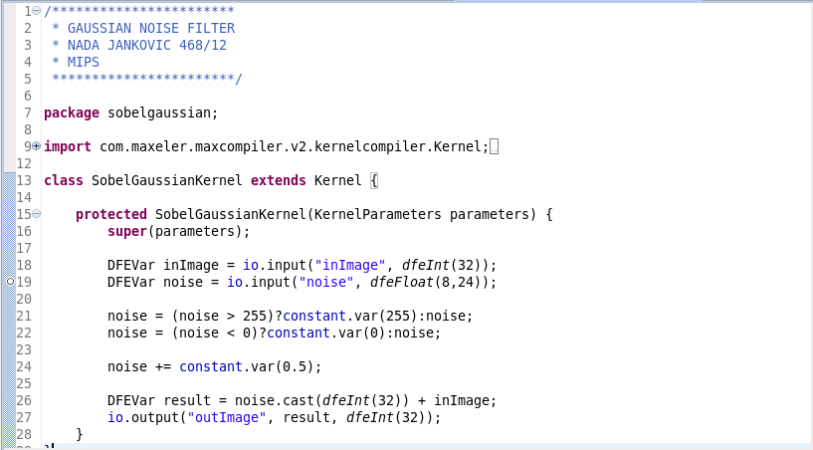
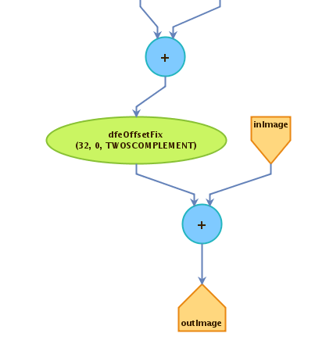
Maxeler Kernel

Slide 9
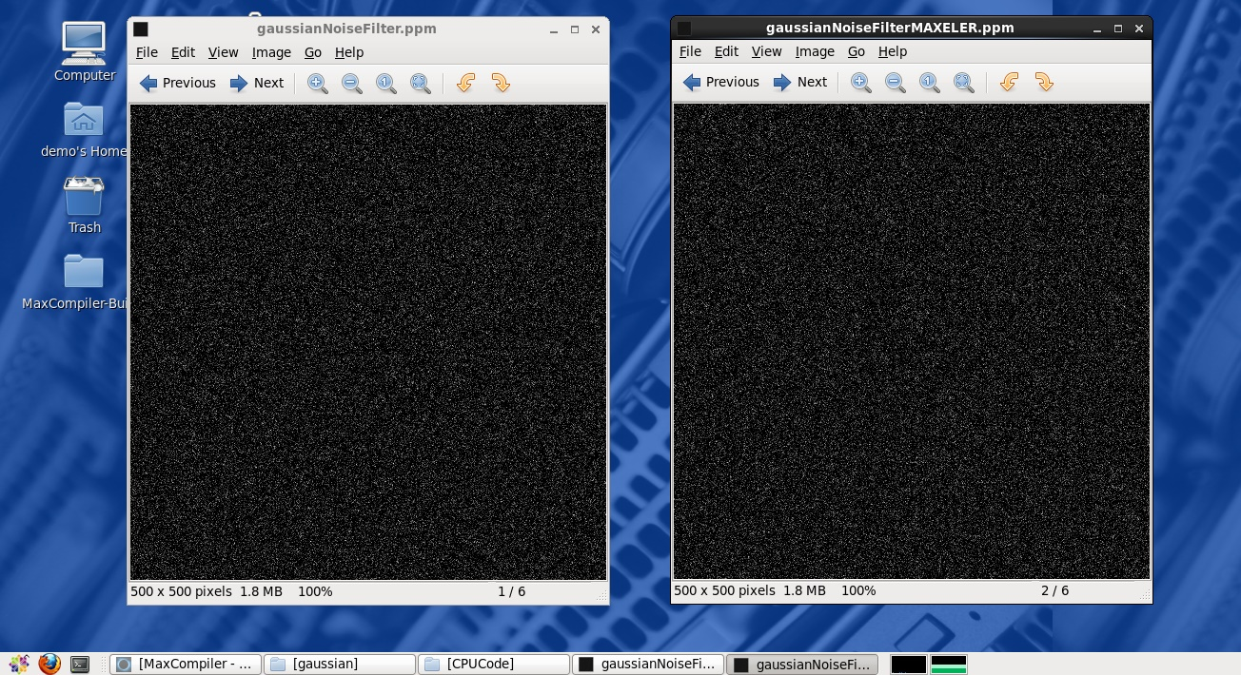

Slide 10


Gaussian Noise in Digital Images

Slide 11
References
Daintith, J. , “Gaussian noise”, A Dictionary of Computing, 2004.
Milutinovic, V., Salom, J., Trifunovic, N., Giorgi, R., “Guide to DataFlow SuperComputing: Basic Concepts, Case Studies, and a Detailed Example”, Springer, 2015.
Milutinovic, V., “Advances in Computers: DataFlow”, Elsevier, 2015.
Stanford University, https://www.stanford.edu/ , January 2016.
http://appgallery.maxeler.com/#/ , January 2016.
https://en.wikipedia.org/wiki/Gaussian_noise , January 2016.

Slide 12


Q & A

